Slide 1
Evaluation of social network sites - Methods for research projects to prepare a bachelor thesis
Tom Sander
tomsander@hotmail.de
Hochschule Ludwigshafen / University of Latvia

Slide 2
Objective
Social networks are an important part of the society. Social network sites are influencing our society. Organisations and individuals can use social network sites for their advantage. This lecture gives an overview how to evaluate social network sites and to collect data in social network sites. Software is useful to research social network sites. This lecture present some software tools to students to research social network sites.

Slide 3
Research
Research is a systematic process of collecting, analyzing, and interpreting information – data – in order to increase our understanding of a phenomenon about which we are interested or concerned.
Good researches always begin a project with open minds about what they may – or may not – discover in their data.
There is no obvious end point – no point at which a researcher can say „Voila I´ve completely answered the question about which I´m concerned.“

Slide 4
Research
… originates with a question or problem.
… requires clear articulation of a goal
… usually divides the principal problem into more manageable sub problems
…. Is guided by the specific plan for proceeding.
Rests on certain critical assumptions.
Requires the collection and interpretation of data in an attempt to resolve the problem that initiated the research.
… is, by its nature, cyclical or, more exactly, helical.
Notes:
Helical - spirallförmig

Slide 5
Hypothesis / Assumptions
A hypothesis is a logical supposition, a reasonable guess, an educated conjecture.
Look for data that will support one of your hypotheses and enables to reject other.
Hypotheses needs variables and explain dependencies
If … than ….
Notes:
Conjecture – vermutung
supposition - Vermutung

Slide 6
What is your assumption / hypotheses about social network sites?
What would you like to know about social network sites?
Why would you like to explain social network sites?
Practical outcome
Theoretical results

Slide 7
Methodology
A research tool is a specific mechanism or strategy the researcher uses to collect, manipulate, or interpret data.
Literature Review – Library, Databases (Ebsco, Emerald …)
Descriptive statistics summarize the general nature of the data obtained – What does the data indicate?
Use of Software like SPSS, R …

Slide 8
The scientific method is a means whereby insight into the unknown is sought by researchers
Identifying a problem that defines the goal of one´s quest
Positing a hypothesis that, if confirmed, resolves the problem
Gathering data relevant to the hypothesis
Analyzing and interpreting the data to see whether they support the hypothesis and resolve the question that initiated research
What is the goal of your research?
Notes:
Quest – Suche
Positing - Schleuse

Slide 9
Theory
If the theory is a viable explanation of the phenomenon under study
Theories explain causal mechanism
Theories help to predict the future
→ But theories do not explain anything and biases are expectable for a part of the society under consideration of the theory!

Slide 10
The problem – Heart of the research process
The first step in the research process is to identify the problem with unwavering clarity and to state it in precise and unmistakable terms.
The problem should lead to new knowledge
The problem should lead to new useful results for the society
Why – that is the question to explain the world and to find a situation
What is the practical / theoretical problem?
Why would be your research valuable?

Slide 11
Variable
A variable is any quality of characteristics in research that investigation that has two or more possible values.
Directly manipulate-able variables are independent
A variable which is influenced by a variable is a dependent variable
Variables should be measurable to evaluate the hypothesis.
→ What could be variables for social network sites research?

Slide 12
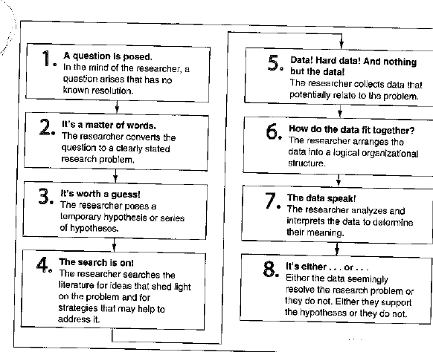
Data collection
Leedy / Ormrod 2013

Slide 13
Data
Access to data
The data should be able to be measured in some ways
Data are those pieces of information that any particulate situation gives to an observer
Research seeks, through data to discover underlying truths
What data would be useful for your social network sites research?

Slide 14
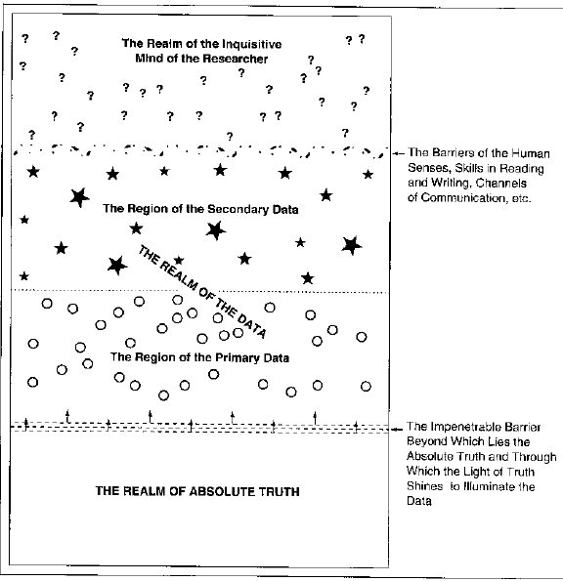
Primary – secondary data
Leedy / Ormrod 2013

Slide 15
Planning for Data collection
What data are needed?
Where are the data located?
How will the data be obtained?
How will be the data interpreted?
→ Pin down your observation by measuring them in some ways

Slide 16
Defining Measuring
Measurement is limiting the data of any phenomenon – substantial or insubstantial – so that those data may be interpreted and, ultimately, compared to a particular qualitative or quantitative standard.
Measurement is ultimately a comparison - a thing or concept measured against a point of limitation.

Slide 17
Nominal scales
→The scale does not have a value order or a measurable different between the variables.
Only a few statistical procedures are appropriate for analyzing nominal data
Indicator for a frequency for example gender
Nominal scales for social network sites?

Slide 18
Ordinal scale
With an ordinal scale of measurement, we can think in terms of the symbols > (greater than) and < (less than)
Rank order of data
We can determine the extent of the relationship between two characteristics by means of Spearman´s rank order correlation.
What kind of ordinal scale data exist for social network sites?

Slide 19
Interval Scales
An interval scale of measurement is characterized by who features
It has equal units of measurement
Its zero point has been established arbitrarily
E.g. meter, Celsius
→ Means, standard deviation, and Pearson product moment correlation can be used
Notes:
Arbitrarily - willkürlich

Slide 20
Correlation
A correlation study examines the extent to which differences in one characteristic or variable are related to differences in one or more other characteristics or variables. A correlation exists if, when one variables increases, another variable either increases or decreases in a somewhat predictable fashion.

Slide 21
Conclusion Scale
One object is different from another → nominal scale
One object is bigger or better or more of anything than another → ordinal scale
One object is so many units (degree, inches) more than another → interval scale

Slide 22
Quantitative and qualitative methods
Quantitative research involves looking at amounts, or quantities or one or more variables of interest
Qualitative research involves looking at characteristics, or qualities, that cannot be entirely reduced to numerical values

Slide 23
Quantitative research
Quantitative researchers often start with one or more specific hypotheses to be tested. They isolate the variable they want to study, use a standardized procedure to collect some form of numerical data, and use statistical procedures to analyze and draw conclusions from the data.

Slide 24
Example Questionnaire
Survey research involves acquiring information about one or more groups of people – perhaps about their characteristics, opinions, attitudes, or previous experiences – by asking them questions and tabulating their answers.
The ultimate goal is to learn about a large population by surveying a sample of the population.
Anonymity
Likert scale – rating scale is useful when a behavior, attitude or other phenomena of interest needs to be evaluated
→ Loosing valuable information because items are provided – questions are closed
Notes:
Tabulating – tabellarisches ordnen

Slide 25
Constructing your questionnaire
Keep it short & simple
Keep the respondents task simple and concrete
Provide straightforward specific instructions
Use simple unambiguous language
Give a rational for any items whose purpose my pe unclear – each question should have a purpose
Check for unwarranted assumptions implicit in your question
Determine in advance how you will code the responses
Check your consistency – answers are social acceptable?
Conduct one or more pilot test to determine the validity of your questionnaire

Slide 26
Using Technology to facilitate Questionnaire
Use e-mail to request participation and obtain participants´ responses
Databases
Publications in communities, networks, forums → convenient sample

Slide 27
Maximize your return
Consider the timing
Make a good first impression
Motivate potential respondents
Offer the results of your study
Be gently persistent

Slide 28
Qualitative research
Qualitative researchers often start with general research questions rather than specific hypotheses, collect an extensive amount of verbal data and ( or nonverbal artifacts, organize those data and artifacts intro some form that gives them coherence, and use verbal descriptions to portray the situation they have studied.

Slide 29
Qualitative research
The term qualitative research encompasses several approaches to research that are in some respects quite different from one another.
little information exists on a topic
variables are unknown
relevant theory base is inadequate or missing
→ A qualitative study can help define what is important – what needs to be studied

Slide 30
Qualitative research
Qualitative research gains increasing understanding of the phenomenon under investigation and so becomes increasingly able to ask more specific questions – an occasionally can formulate and test specific hypotheses as well
Separate important information – identify the needed information
Many unimportant details
Subjective analysis / interpretation

Slide 31
Qualitative research for Social network sites
Interviews
Semantic analysis
Observations
Case studies – comparing different situations

Slide 32
Example quantitative / qualitative research - interviews
Facts
People´s beliefs and perspectives about the facts
Feelings
Motives
Present and past behaviors
Reasons / explanations
People are apt to recall what might or should have happened (based on their attitudes, thoughts or beliefs) rather than what actually did happen.
Notes:
Apt - begabt

Slide 33
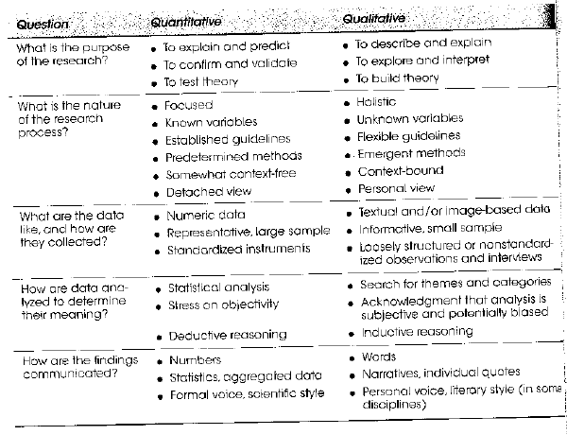
Leedy / Ormrod 2013

Slide 34
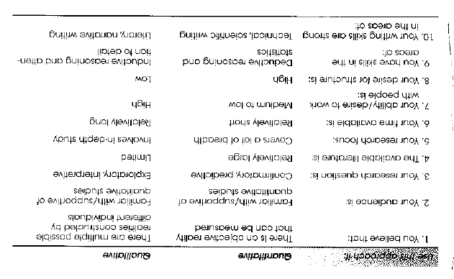
Leedy / Ormrod 2013

Slide 35
What kind of research …
Would you use quantitative or qualitative research for your scientific problem?
Why would you use this kind of research?

Slide 36
Triangulation of research
Multiple sources of data collected
Mix of methods
Deeper insight
Support of the results
More explanations

Slide 37
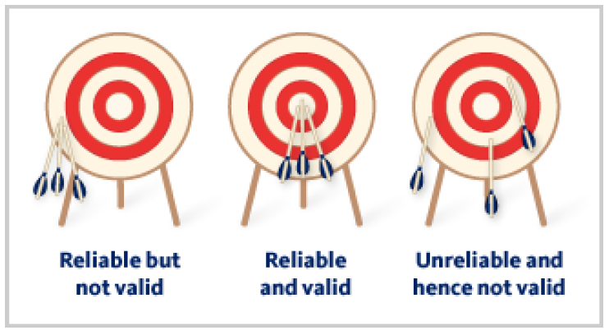
Validity & Reliability
Validity of a measurement instrument is the extent to which the instrument measure what it is intended to measure.
Reliability is the constancy with which a measuring instruments yields a certain, consistent result when the entity being measured hasn´t changed.

Slide 38
Possible biases
Validity errors reflect biases in the instruments itself
Ratability errors reflect use of the instrument and are apt to vary unpredictably from one accession to the next
Notes:
Accession – Zugang
Ratability – Schätzbar, antielmäßig

Slide 39
Sample
Results obtained from the sample to make generalization about the entire population only if the sample is truly representative of the population – nearly impossible for student work
In general the sample should be so carefully chosen that through it, the research is able to see characteristics of the total population in the sample proportion and relationship that they would be seen if the researcher were, in fact to examine the total population.

Slide 40
Probability Sampling
In Probability sampling, every part of the population has the potential to be represented in the sample. The sample is chosen from the overall population by random selection.
But nobody explains what means random selection? What means random.
? The purpose of randomness is to let blind chance determine the outcome of the selection process to as great as possible?

Slide 41
Sample random sampling
Every member of the population has an equal chance of being selected
Simple random sampling is neither practical nor, in many cases possible

Slide 42
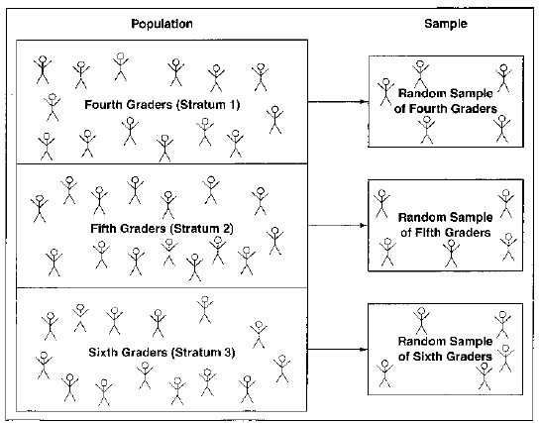
Stratified random sampling
Leedy / Ormrod 2013
Notes:
Stratified - geschichtet

Slide 43
Nonprobability Sampling
In nonprobability sampling, the researcher has no way of predicting or guaranteeing that each element of the population will be represented in the sample.
→ Convenience sampling – also known as accidental sampling – makes no pretense of identifying a representative subset of a population. It takes people or other units that are readily available.
→ Quota sampling is a variation of convenience sampling. It selects respondents in the same proportions that they are found in the general population, but not in a random fashion.
Notes:
Probability - Wahrscheinlichkeit

Slide 44
Identifying a sufficient sample size
Sample size depends on population!
Population less than 100, survey the entire population
Population less than 500 and more than 100 survey 50%
Population over 500, survey 20%
Population above 5 000, survey more than 400 member of the population
→ http://www.raosoft.com/samplesize.html for a first step but be careful and use more scientific sources!!!

Slide 45
Biases
Nonprobability sampling has a disadvantage. People who happen to be readily available for a research project – those who are in the right place at the right time – are almost certainly not a random sample of the overall population.
When formulating conclusions about the data a researcher must be sure to consider the effect that bias may have had in distorting the data
Researcher have to point out precisely how bias may have infiltrated the research design. With this knowledge, other scholars can realistically appraise the research and judge its merits.

Slide 46
Experiments
Facebook provided to group A positive posts and to group B negative posts.
Than Facebook evaluated the posts of group A and B to find out if the post content influence individuals – C has been control group.
Negative posts have a negative influence
Ethical question

Slide 47
Analyzing data
Isolate the data
How the research prepares the data for inspection will affect the meaning that those data reveal. Therefore every research should be able to provide a clear, logical rational for the procedure used to arrange and organize data.

Slide 48
Analyzing data
Frequency, mean, median, correlation ….
What are needed to answer the research question and is useful for your research?
What kind of analyze tool describes your data, mechanism, explain your hypothesis?

Slide 49
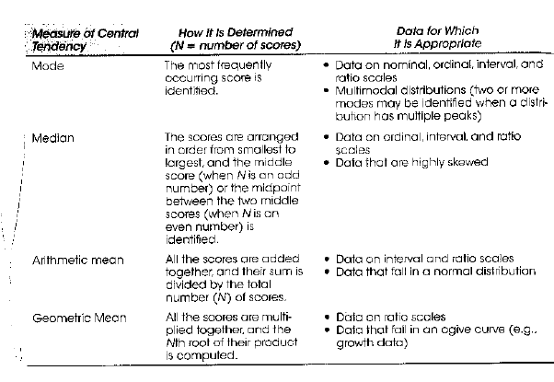
Leedy /
Ormrod 2013

Slide 50
Node XL
www.nodexl.com
http://socialnetimporter.codeplex.com/downloads/get/1439747

Slide 51
context
http://context.lis.illinois.edu/

Slide 52
Thank you for your attention!
Questions? Comments?

